Slide 1
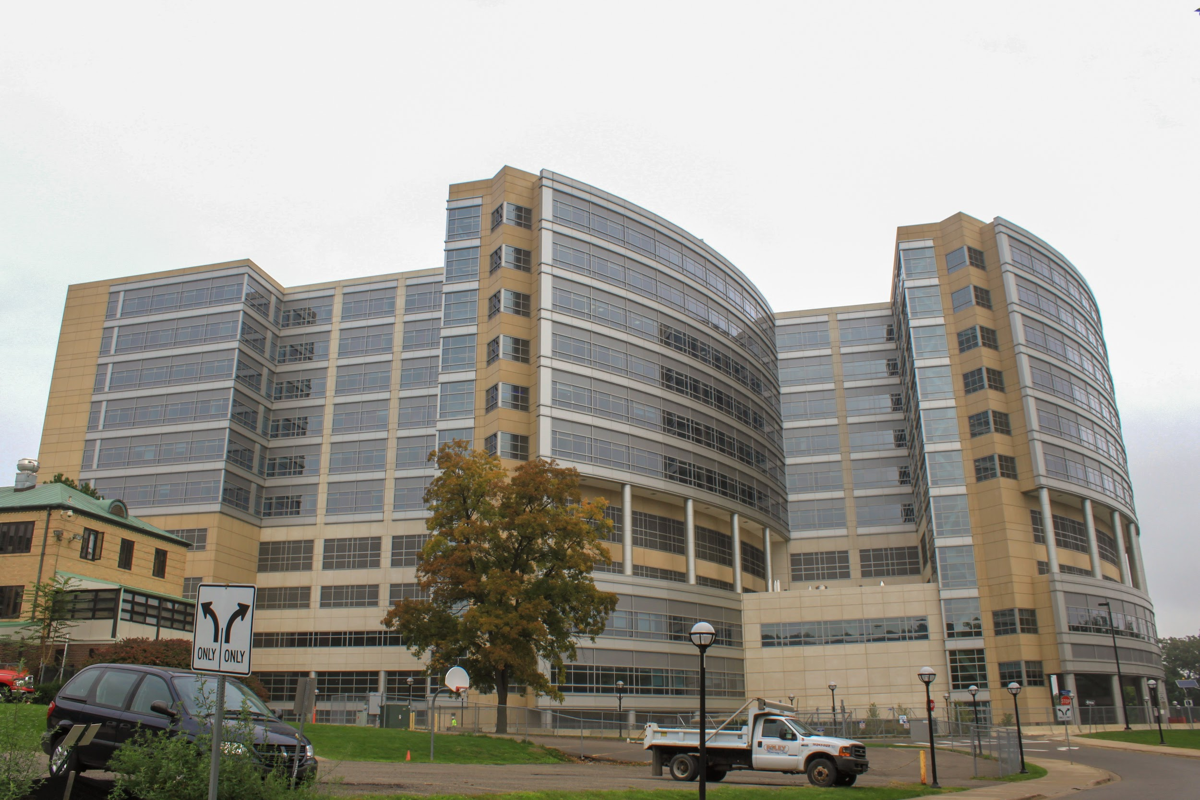
Hospital Admission Rates
Pratap Gude (gvnsp)
Andy Higuera (andyhig)
Dataset: From open source Canvas website : https://umich.instructure.com/courses/38100/files/folder/Case_Studies/18_HospitalAdmissions?preview=5005926

Slide 2
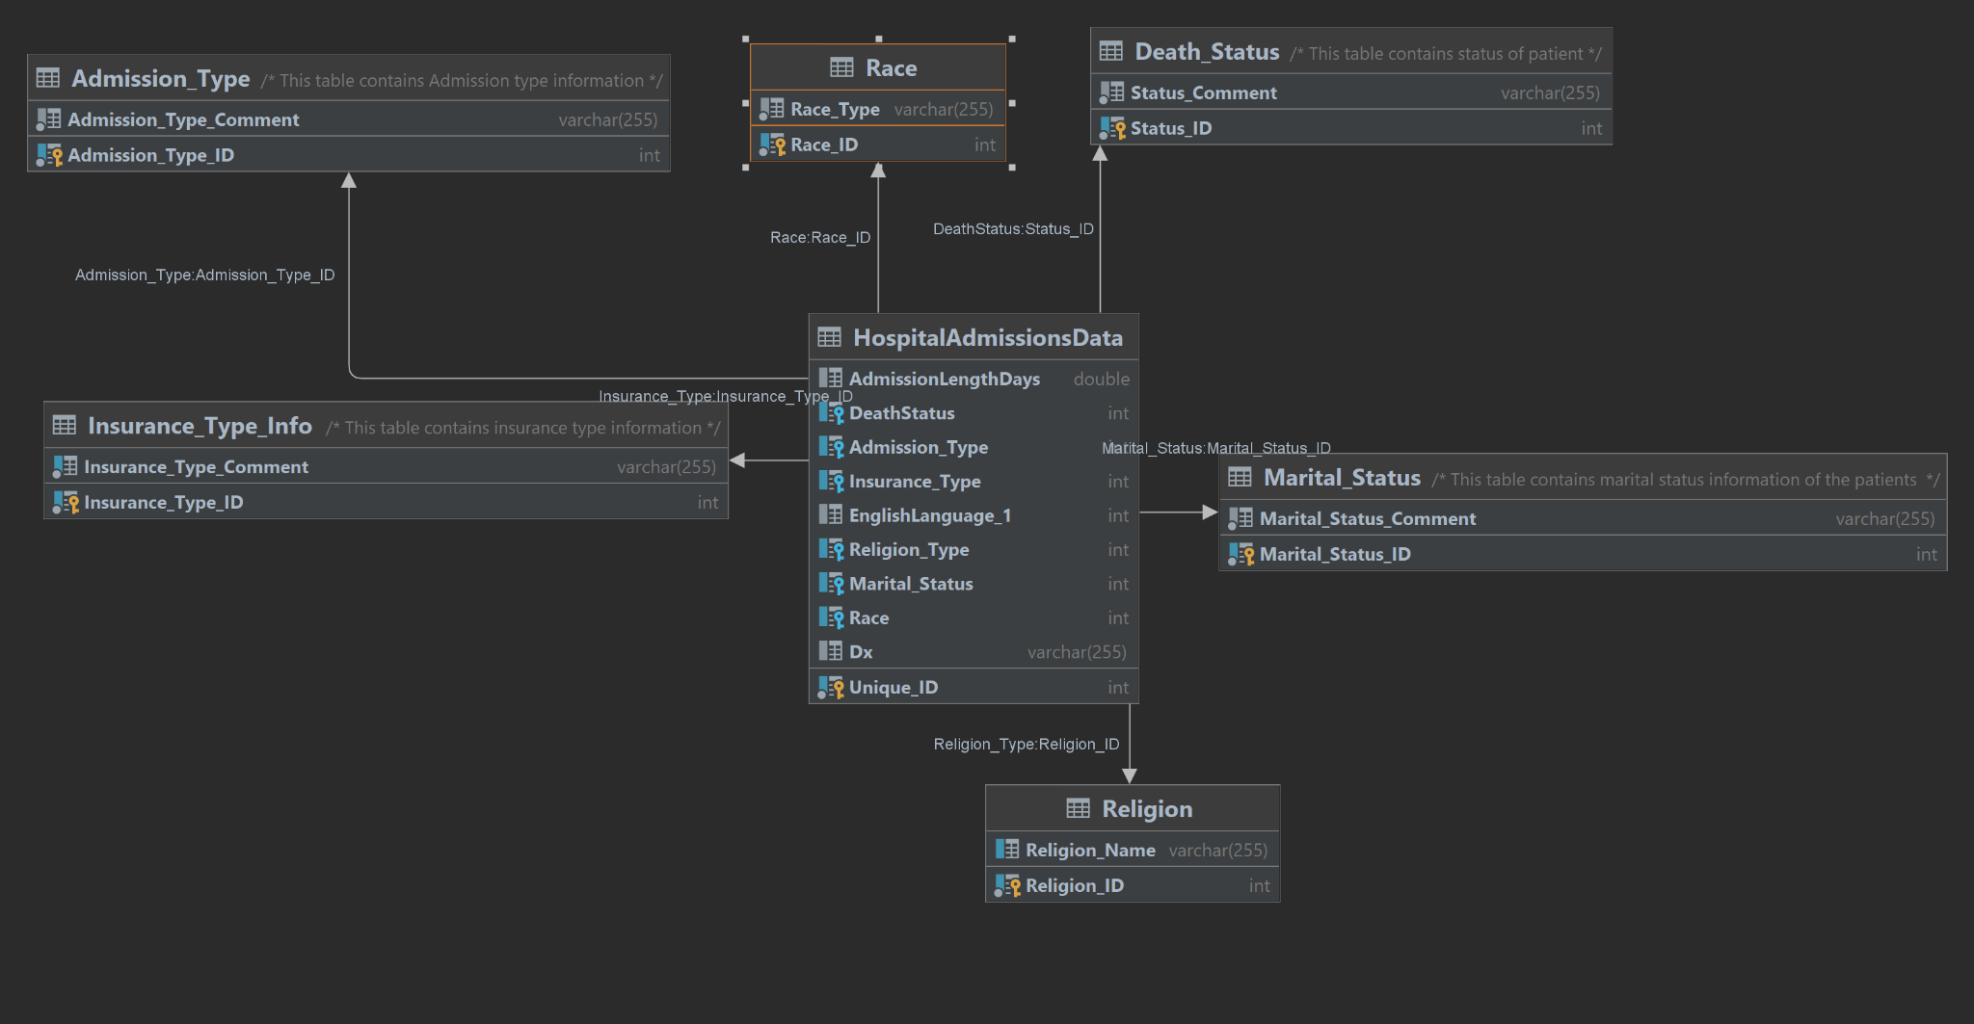
Notes:
Infant deaths was surprisingly very high for this hospital: >98%
More medicare patients visit this hospital.
Must provide better care to neonatal unit to improve infant mortality rates.

Slide 3
Tell us about getting data into your database
Downloaded the dataset, cleaned in excel and uploaded them on datagrip. Created database using queries and uploaded the .csv file
What was the most complex thing?
Cleaning the dataset
Updating categorical data and normalizing them using sub tables.

Slide 4
Favorite question:
The most insightful question we asked in this project was about the most deaths that occur in the hospital. This let us know the most pressing issue at the hospital.
In future:
We could integrate datagrip with git and add on a server to log into the database. Tokenize the frequent search times to create a web interface which provides insights to C-Suite people at the hospital.

Slide 5
Thank you

